Slide 1
LDACS Briefing Current Status of LDACS Development and Standardization
Prepared by Project Team Terrestrial Data Link (PT-T) of the ICAO Communications Panel
Presented to FSMP
March 2021

Slide 2
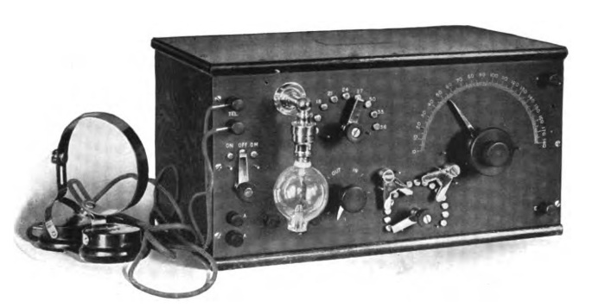
Motivation
SESAR
Worldwide ATM modernization
For increased efficiency
Reduce overall ATM costs
For increased safety and security
Stay number one in safety, harden against cyber attacks
For increased capacity
Overcome airspace capacity challenge
For greener air transportation
Higher and continuing public acceptance
NextGen
CAAMS
Requires modernization of CNS technologies, especially improved and secure connectivity.
CARATS
Notes:
CARATS: Collaborative Actions for Renovation of Air Traffic Systems
CAAMS: China's Civil Aviation ATM Modernization Strategy

Slide 3
Outline
What is LDACS?
What does LDACS offer?
How will LDACS be deployed?
What is the current status of LDACS?

Slide 4
What is LDACS?
LDACS stands for L-band Digital Aeronautical Communications System and is
the upcoming broadband and secure terrestrial communications system for aviation
originally developed under EUROCONTROL contract and being refined within SESAR 2020
exclusively designed for aviation use in protected aeronautical L-band with AM(R)S allocation
well positioned in SESAR’s ATM Master Plan and essential part of the FCI
well reflected in ICAO’s Global Air Navigation Plan
under ICAO standardization (Communications Panel)
The Future Communications Infrastructure (FCI)
SatCom
LDACS A2A
LDACS is a mature technology for aviation!
Flight trials have taken place March/April 2019
LDACS
LDACS
AeroMACS

Slide 5
What is LDACS?
LDACS System Characteristics
State-of-the-art technology as used in LTE/4G
Based on OFDM modulation technology
Orthogonal Frequency-Division Multiplexing
Multi-carrier technology
Modern, highly flexible and scalable
Efficient coding and adaptive coding/modulation
Covers QPSK, 16-QAM, 64-QAM
Concatenated coding scheme using combination of Reed Solomon and convolutional code
Interleaving
Main LDACS Parameters:
Number of subcarriers 64 (50 used)
Bandwidth 625 / 488 kHz
Subcarrier spacing 9,765625 kHz
OFDM symbol duration 102,4 µs
Guard interval (4,8 + 12,8) µs
Net data rate 550 kbit/s – 2,6 Mbit/s
(at least 50-times VDL Mode 2 capacity)

Slide 6
What is LDACS?
LDACS System Characteristics
LDACS inlay approach: Deployment in L-band among DME channels
Ensuring the right frequency separation and geographic distance
Suppression of out-of-band radiation towards other L-band systems
Mitigation of L-band interference from other L-band systems
Cellular communications concept
Apply FDD due to limited bandwidth available with inlay approach
Forward Link: 1110 – 1125 (1156) MHz
Reverse Link: 964 – 979 (1010) MHz

Slide 7
What does LDACS offer?
A variety of useful features and capabilities
Broadband Connectivity to enable modern ATM concepts
LDACS is based on technology as applied for LTE/4G mobile radio systems
High-rate data communications with 550 kbps – 2.6 Mbps per channel (55 – 260 times VDL2)
Improved communications performance to overcome current deficiencies
LDACS provides both data link connectivity and digital voice
Low-latency transmission through coordinated channel access
Service priorities ensure low-latency and high continuity of service for safety-critical ATS and AOC
No co-channel interference problems as experienced during VDL2 data link deployment
Secure transmissions through built-in cyber-security means
Ensuring mutual entity authentication
Protecting confidentiality, integrity and authenticity of messages
Ensuring availability and continuity of service

Slide 8
What does LDACS offer?
A variety of useful features and capabilities
Simultaneous transmission of ATS and AOC services
Each service transmits according to its priority suitable for the service requirements
Transmission of high-volume AOC data while ensuring immediate access for safety-critical services
LDACS covers ATN/B1 and ATS/B2 as well as emerging ATS/B3 and additional future services including full 4D TBO, flight-centric ATM, secure connectivity to the flight deck, and secure GBAS
Integrated CNS
Communications for ATS and AOC services – main task
Navigation/positioning through ranging to ground stations providing enhanced APNT capabilities
Surveillance through detection of airborne LDACS transmissions at ground stations
Potential extensions under current consideration
Extension towards direct air-air communications (LDACS A2A)
Extension towards Command & Control link for single-piloted aircraft or RPAS

Slide 9
What does LDACS offer?
Special benefits for airlines
LDACS enables improved and secure aircraft connectivity
High-volume, secure AOC and ATS communications for improved operational efficiency
Secure, private communications for aircraft operators including AOC VoIP connections to aircraft
LDACS enables modern ATM procedures ➔ increased airspace capacity, reduced delays and costs
Full 4D trajectory-based operations and flight-centric ATM for increased airspace capacity and safety
Air-traffic becomes more predictable and is handled more efficiently, improving punctuality and costs
Less detours and waiting times/patterns reduce fuel burn
LDACS assists transformation towards greener aviation
Modern ATM procedures result in reduced fuel burn
Noise optimized routes over populated areas reduce noise foot prints and increase public acceptance

Slide 10
How will LDACS be deployed?
With a valid business case for airlines/airframers
Main guideline: Re-use existing infrastructure on-board and on ground as far as possible to reduce costs
Re-use avionics installation
Bring LDACS on-board without additional antenna or avionics box
Develop combined VDL/LDACS radio in a single avionics box
Exchange VHF antenna with a combined VHF-/L-band antenna having the same footprint
Advantages
Almost one-to-one exchange of VDL with combined VDL/LDACS radio
Reduced aircraft downtimes and reduced installation costs
Gradual introduction of LDACS possible starting where broadband connectivity is needed most
Aircraft can use LDACS wherever deployed on ground, otherwise VDL is used
Use and return of investment starts with the first LDACS ground installation

Slide 11
How will LDACS be deployed?
With a valid business case for CSPs/ANSPs
Main guideline: Re-use existing infrastructure on-board and on ground as far as possible to reduce costs
Re-use existing ground infrastructure
Coverage area of a single LDACS ground station is comparable to VDL coverage
Advantages
Ground station installations can be re-used
Network infrastructure can be re-used
Re-use existing service infrastructure
CSPs can offer a broadband service where available as complement to the VDL service
Advantages
CSPs can use their infrastructure and client base
Seamless introduction of a broadband service to airlines (AOC) and ANSPs (ATS)

Slide 12
What is the current status of LDACS?
LDACS is well established and under ICAO standardization
LDACS design is completed and technical specifications are available and published
Demonstrator equipment has been produced by Frequentis, Rohde & Schwarz, and Leonardo
Flight trials using industrial demonstrator equipment have been performed in March/April 2019
Four LDACS ground stations and one LDACS airborne installation
LDACS functionalities and capabilities have been demonstrated in realistic scenarios
LDACS is well established in
ICAO’s Global Air Navigation Plan (GANP)
SESAR’s ATM Master Plan
Eurocontrol’s future communications infrastructure (FCI)
ICAO standardization was initiated in October 2016
LDACS Draft SARPs have been endorsed by the Communications Panel in October 2018
Work on SARPs Validation and LDACS Manual is ongoing
The aim is to have an applicable standard from 2024 onwards

Slide 13
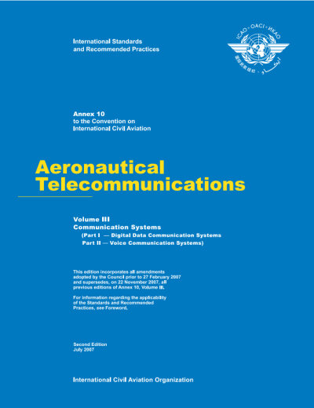
What is the current status of LDACS?
Timeline towards LDACS applicability
Development of LDACS Manual
Guidance
Material
Validation
Document
Update of
SARPs
Validation
of SARPs
Applicability
2019
2020
2021
2022
2023
2024
Q3/2022

Slide 14
Thank you for your attendance!
Contact details:
Michael.Schnell@dlr.de
For more information, see:
www.ldacs.com

